Slide 1

NorthStar Living UK: Retail Performance Dashboard & Insights
JUMMA MOHAMMAD TELI
Tool: Power BI

Slide 2

Business Context & Objective
NorthStar Living UK is a mid-sized retail business operating across multiple UK regions through both online and in-store channels. The company wants to better understand its sales performance, profitability, customer behaviour and return patterns.
The objective of this analysis is to build a dashboard that provides clear insights into revenue, profit, discounting, customer segments, returns and operational performance to support better decision-making.

Slide 3
Key Performance Overview
Total Revenue reached £733K with strong overall performance
Profit margin stands at 31%, indicating healthy profitability
Return rate remains relatively low at 3.66%
Customer satisfaction averages 4.17, showing positive customer experience

Slide 4
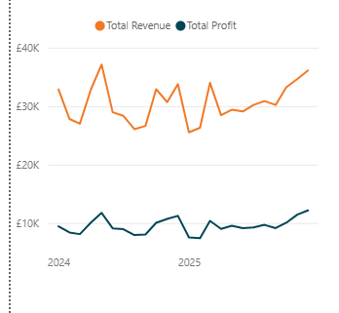
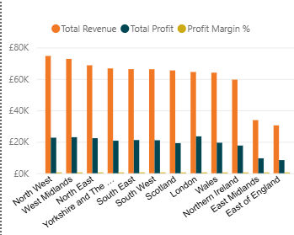
Regional and Time-Based Performance
Revenue and profit show stable growth over time with slight fluctuations
Certain regions outperform others in both revenue and profitability
Some regions generate high revenue but relatively lower profit margins, indicating cost or discount pressure

Slide 5
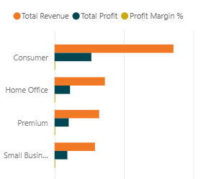
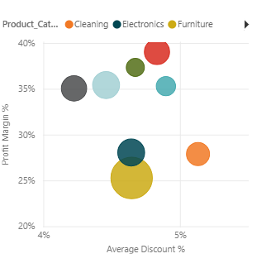
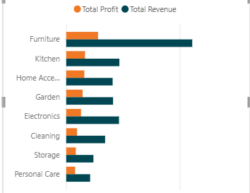
Product and Customer Segment Insights
Furniture and kitchen categories contribute the most to overall revenue
Customer segment analysis shows that the Consumer segment is the most valuable
Higher discount levels do not always lead to higher profitability and may reduce margins in some categories

Slide 6
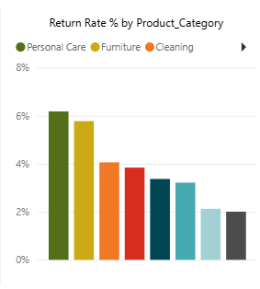
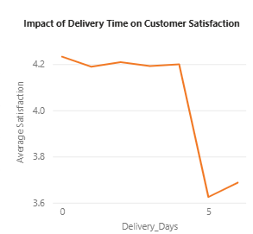
Returns and Operational Insights
Returns are concentrated in specific product categories such as personal care and furniture
Increased delivery time negatively impacts customer satisfaction
Faster delivery is strongly associated with better customer experience

Slide 7
Key Recommendations
Review discount strategy in low-margin categories
Investigate high-return product categories to reduce losses
Improve delivery performance to increase customer satisfaction
Focus marketing efforts on high-value customer segments
Monitor regional profitability rather than revenue alone

Slide 8

Next Steps
Track performance regularly using the dashboard
Conduct deeper product-level profitability analysis
Improve operational efficiency in delivery processes
Explore customer feedback to reduce return rates

